Slide 1
Install Autoware.Auto
2021.10.05

Slide 2
System Architecture
ROS:
．Launch Programs
．Pub/Sub Based Message System
Lidar, camera, and GPS data
Vehicle status
Autoware:
．Driving Control
．Localization
．Detection
LGSVL:
．Vehicle Simulator
．Autonomous Driving Testing
Steering, accelerator, etc.

Slide 3
Installation
Ubuntu 20.04
LG Simulator
Docker-ce
Autoware.auto

Slide 4
Hardware Requirements
Minimum requirement:
4 GHz Quad core CPU
NVIDIA GTX 1080 (8GB memory) or higher
Ubuntu 20.04 (64-bit)
Tested environment:
CPU: I7-9750
GPU: GTX-2070S
OS: Ubuntu 20.04 (64-bit)
Driver:
NVIDIA-SMI 470
CUDA 11.4

Slide 5
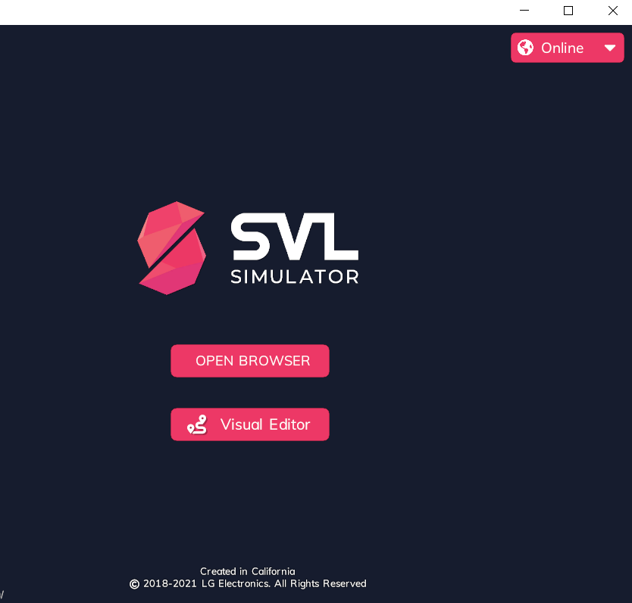
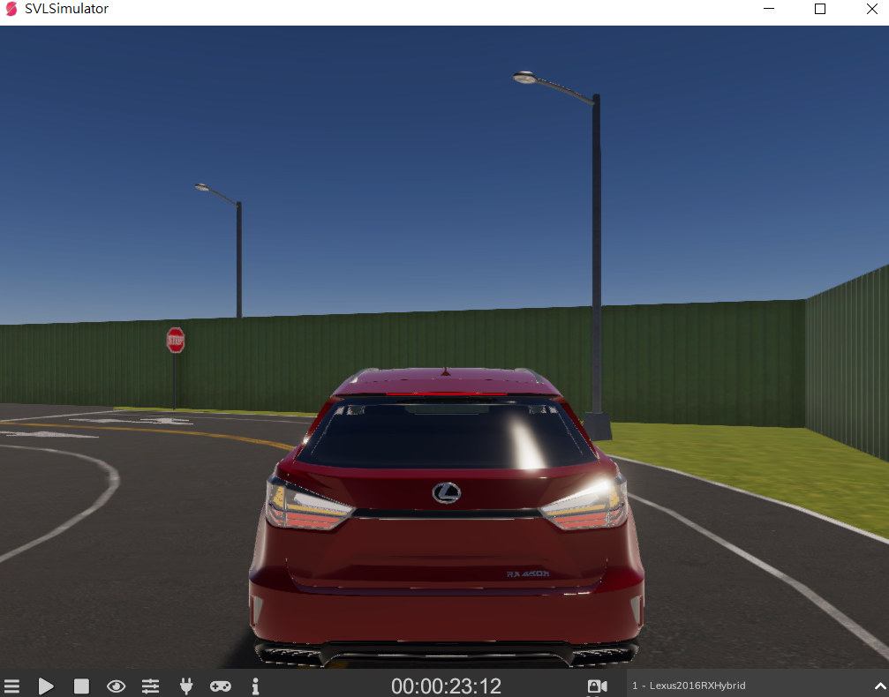
LGSVL
https://www.svlsimulator.com/
Download and run the simulator (version: 2021.2.2).
Open the GUI via browser.
Setup and run any simulation.
https://wise.svlsimulator.com/tutorials

Slide 6
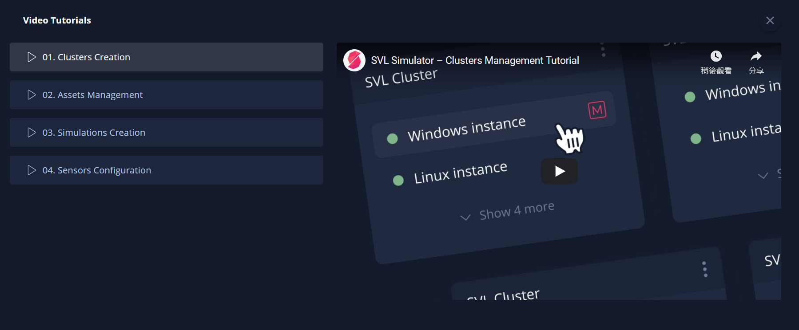
Video Tutorials

Slide 7
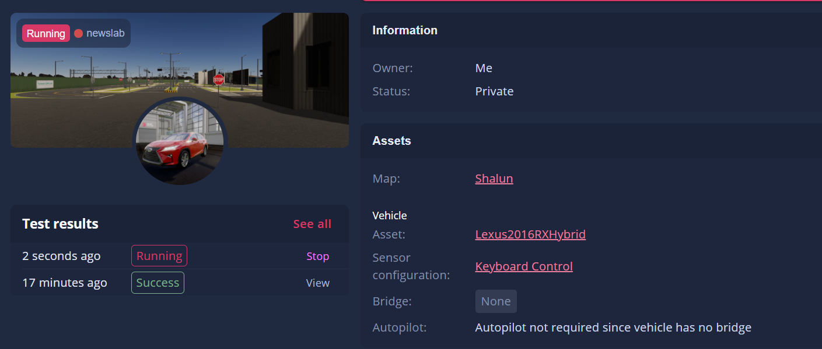
Simulation Setting Example

Slide 8
LGSVL Control
F1: open help menu.
Arrows: steering and acceleration
N: other vehicles
Start button

Slide 9
Autoware CHECK!!
Autoware.auto: ROS-based commercial software, enabling self-driving vehicles with functional safety capabilities.
https://www.autoware.org/training
Functionalities in autoware:
Localization depends on 3D high-definition map data and the NDT algorithm. The result of Localization is complemented by the Kalman Filter algorithm, using odometry information obtained from CAN messages and GNSS/IMU sensors.
Detection is empowered by camera and LiDAR devices in combination with 3D high-definition map data. The Detection module uses deep learning and sensor fusion approaches.
Tracking and Prediction are realized with the Kalman Filter algorithm and the lane network information provided by 3D high-definition map data.
Planning is based on probabilistic robotics and rule-based systems, partly using deep learning approaches as well.
Control defines motion of the vehicle with a twist of velocity and angle (also curvature). The Control module falls into both the Autoware-side stack (MPC and Pure Pursuit) and the vehicle-side interface (PID variants).

Slide 10
Install Autoware
https://www.svlsimulator.com/docs/system-under-test/autoware-auto-instructions/
Install Docker-ce
Download ADE
https://www.svlsimulator.com/docs/system-under-test/autoware-auto-instructions/#Install-ADE
Autoware Development Environment
Download Autoware.Auto source code
Install ROS2 LGSVL Bridge
Building from source might be better.
Start the Autoware.Auto containers with NVIDIA setup
Notes:
https://ade-cli.readthedocs.io/en/latest/intro.html#

Slide 11
Docker
https://docs.docker.com/engine/install/ubuntu/
Follow the instructions to install the docker
After docker installed, you can add yourself to docker’s group.
sudo groupadd docker
sudo usermod -aG docker $USER
logout and login again
https://docs.docker.com/engine/install/linux-postinstall/
By adding into docker group, you don’t need to use sudo to run docker.

Slide 12
Nvidia container toolkit
https://docs.nvidia.com/datacenter/cloud-native/container-toolkit/install-guide.html
Testing: docker run --rm --gpus all nvidia/cuda:11.0-base nvidia-smi
distribution=$(. /etc/os-release;echo $ID$VERSION_ID)
curl -s -L https://nvidia.github.io/nvidia-docker/gpgkey | sudo apt-key add -
curl -s -L https://nvidia.github.io/nvidia-docker/$distribution/nvidia-docker.list | sudo tee /etc/apt/sources.list.d/nvidia-docker.list
sudo apt-get update && sudo apt-get install -y nvidia-container-toolkit
sudo systemctl restart docker

Slide 13
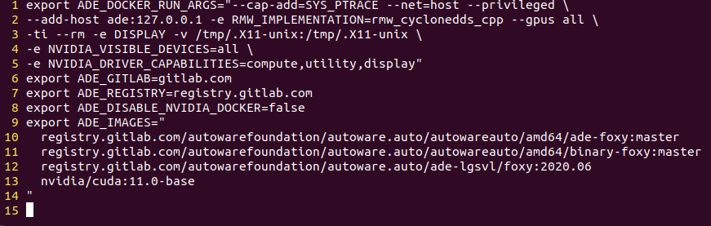
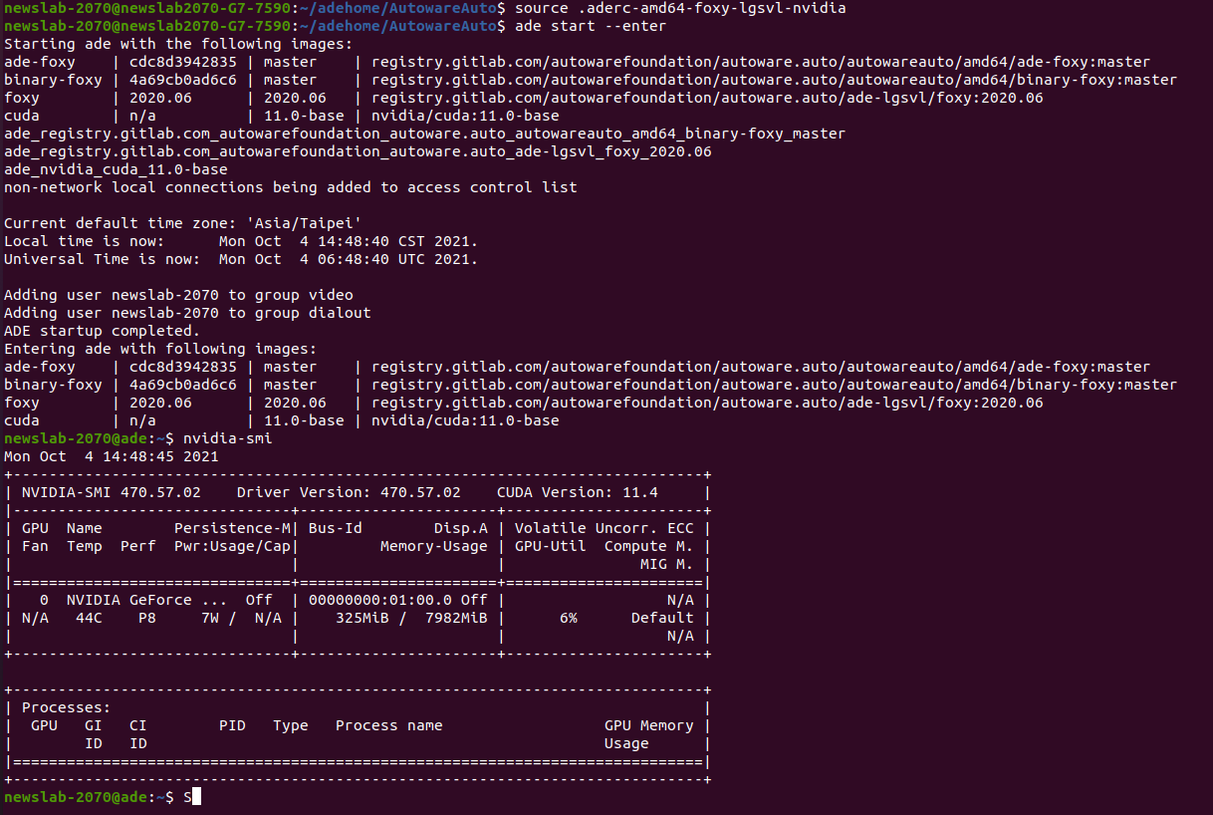
Example of aderc

Slide 14
Submit
You need to submit two screen shot to NTU COOL
First one is the result of running nvidia-smi in ade.
Second one is the screen shot of LGSVL using Shalun map as page 8..

